Slide 1

DIABETICS PREDICTION USING MACHINE LEARNING

Slide 2
Introduction:
Diabetes is a chronic disease that is prevalent among people of all age groups. Detecting this disease at an early stage can help individuals take necessary precautions and adjust their lifestyle to either prevent its occurrence or manage the disease effectively for those who already have it.
In this project, we aim to build a basic model to predict whether a person has diabetes using the Pima Indians Diabetes Database. This dataset is commonly used in machine learning practice and contains various health-related attributes for Pima Indian women, along with a label indicating whether or not each woman developed diabetes.
We will employ classification algorithms and Python tools such as numpy and pandas for data manipulation. Additionally, we will utilize matplotlib and seaborn for visualizations to gain insights into the data and better understand the relationships between different attributes and the target variable.
By developing an accurate predictive model, we hope to contribute to early detection of diabetes and empower individuals to make informed decisions about their health and lifestyle choices.

Slide 3
Steps Involved to Diabetic prediction:
1) Importing Libraries
2) Loading Dataset
3) Exploratory Data Analysis(EDA)
4) Feature Selection
5) Feature Scaling
6) Splitting the Dataset
7) Mechine Learning Model
---Prediction using Logistic Regression
---Prediction using Decision Tree Classifier
---Prediction using Random Forest Classifier
---Prediction using Support Vector Classifier

Slide 4
1) Importing Libraries:
Importing some basic libraries like Numpy ,Pandas, Matplotlib, seaborn.
Numpy:
NumPy stands for Numerical Python and is one of the most useful scientific libraries in Python programming. It provides support for large multidimensional array objects and various tools to work with them.
import numpy as np
Pandas:
Pandas is a Python library used for working with data sets. It has functions for analyzing, cleaning, exploring, and manipulating data. The name "Pandas" has a reference to both "Panel Data", and "Python Data Analysis“.
import pandas as pd

Slide 5
Matplotlib:
Matplotlib is one of the most popular Python packages used for data visualization.
Cross-platform library for making 2D plots from data in arrays.
import matplotlib.pyplot as plt or
from matplotlib import pyplot as plt
Seaborn:
Seaborn is a data visualization library built on top of Matplotlib, designed to create visually appealing and informative statistical graphics. It provides a high-level interface for creating a variety of charts, such as heat maps, scatter plots, line plots, and many others
import seaborn as sns

Slide 6
2) Loading Dataset:
Pima Indians Diabetes Database
Dataset downloaded from Pima Indians Diabetes Database
The read_csv() is written as follows:
data_set= pd.read_csv(‘Dataset.csv’)
The datasets consist of several medical predictor (independent) variables and one target (dependent) variable, Outcome. Independent variables include the number of Pregnancies the patient has had, their Glucose, BloodPressure, SkinThickness, Insulin,BMI, DiabetesPedigreeFunction,Age.

Slide 7
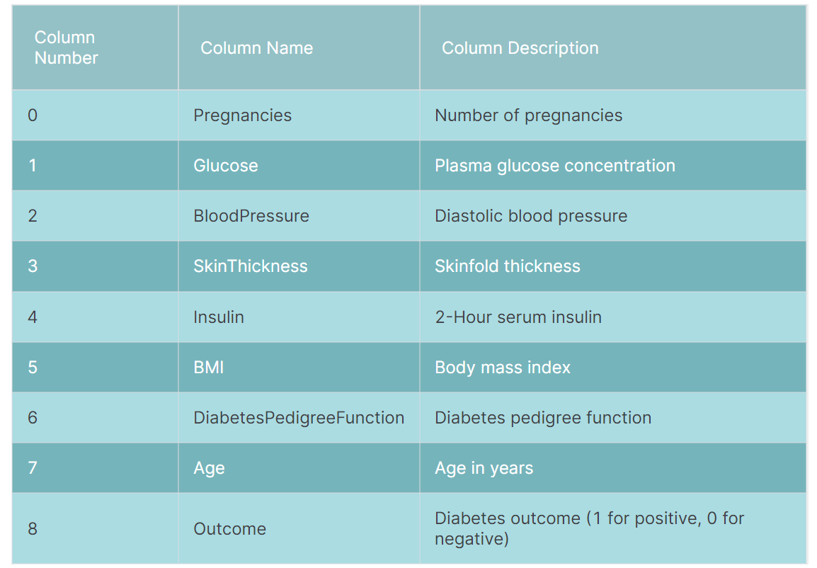

Slide 8
3) Exploratory Data Analysis(EDA):
In Python, exploratory data analysis, or EDA, is a crucial step in the data analysis process that involves studying, exploring, and visualizing information to derive important insights. To find patterns, trends, and relationships in the data, it makes use of statistical tools and visualizations.

Slide 9
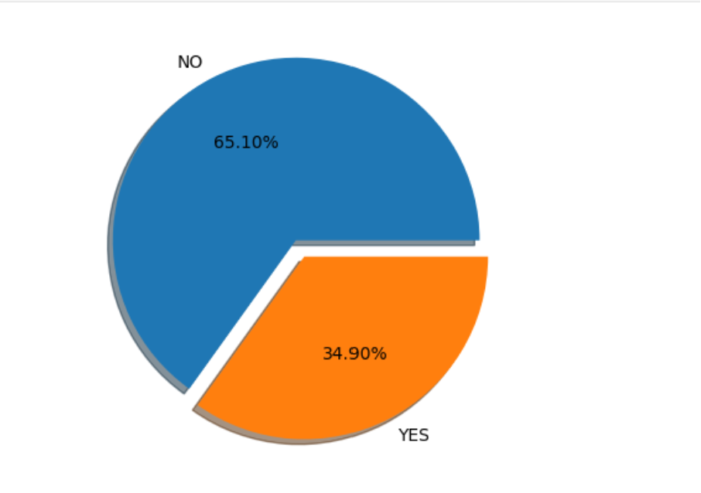
Pie Diagram:
A pie chart (or a circle chart) is a circular statistical graphic which is divided into slices to illustrate numerical proportion. In a pie chart, the arc length of each slice (and consequently its central angle and area) is proportional to the quantity it represents.
plt.pie(outcome_count,labels=["NO","YES"], shadow=True, autopct='%1.2f%%',radius=1,explode=[0.05,0.05])

Slide 10
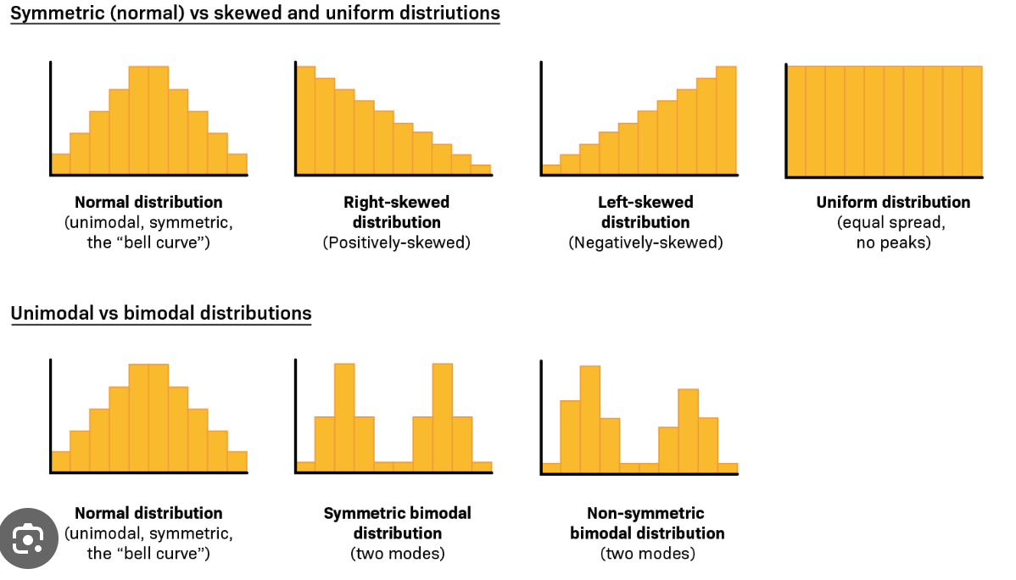
Histogram:
A histogram is a graph that shows the frequency of numerical data using rectangles. The height of a rectangle (the vertical axis) represents the distribution frequency of a variable (the amount, or how often that variable appears).
sns.histplot(data=df, x=feature, hue="Outcome", kde=True)

Slide 11
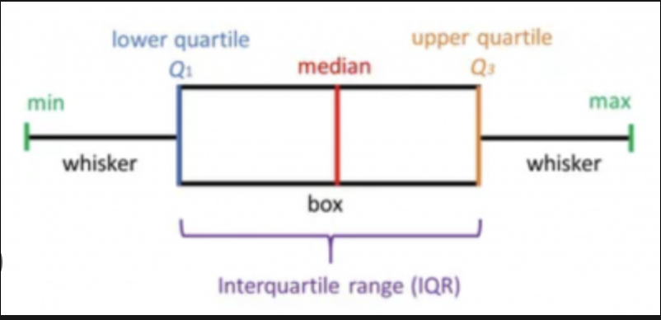
Box plot:
A box and whisker plot or diagram (otherwise known as a boxplot), is a graph summarising a set of data. The shape of the boxplot shows how the data is distributed and it also shows any outliers. It is a useful way to compare different sets of data as you can draw more than one boxplot per graph.
sns.boxplot(data=df, x="Outcome", y=feature ,hue="Outcome")

Slide 12
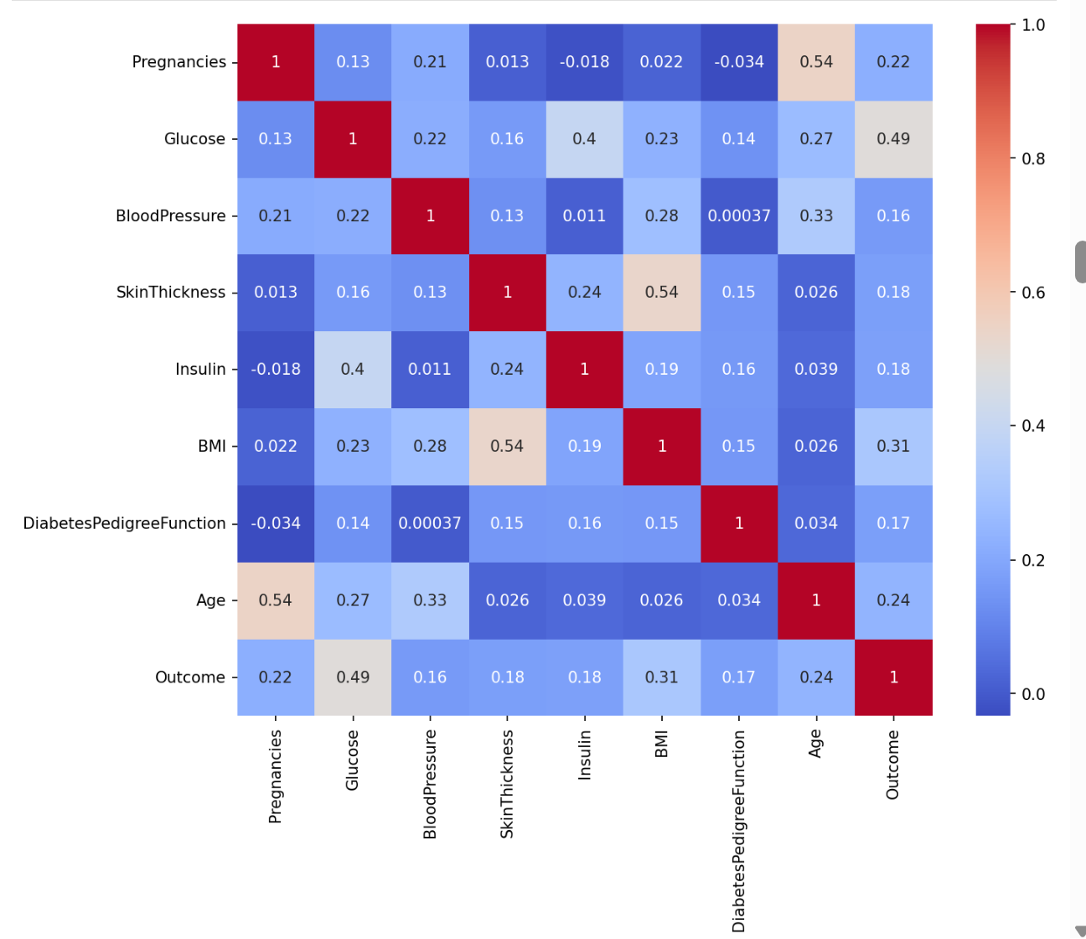
Heat map:
A heatmap (or heat map) is a graphical representation of data where values are depicted by color.
plt.figure(figsize=(10,8),dpi=150)
# Create correlation matrix
corr = df.corr(numeric_only=True)
# Create heatmap
sns.heatmap(corr, annot=True, cmap='coolwarm');

Slide 13
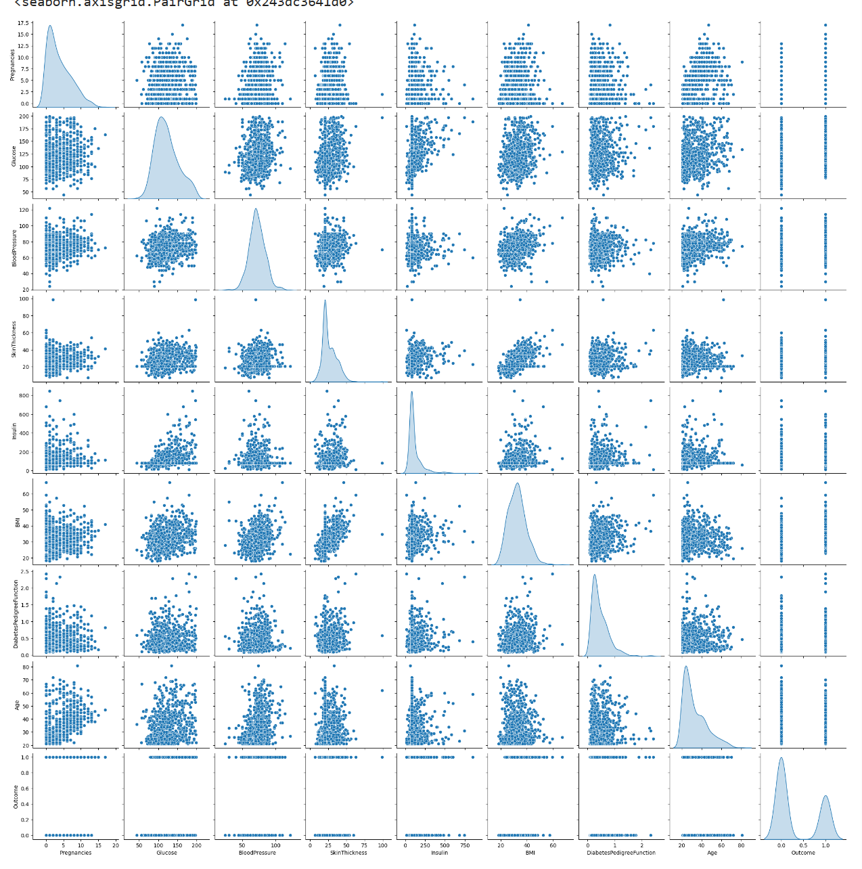
Pair plot:
A pairplot plot a pairwise relationships in a dataset.
sns.pairplot(df,diag_kind='kde')

Slide 14
4) Feature Selection:
Feature Selection is the method of reducing the input variable to your model by using only relevant data and getting rid of noise in data. It is the process of automatically choosing relevant features for your machine learning model based on the type of problem you are trying to solve.
x = df1.drop(['Outcome'], axis=1)
y = df1['Outcome']

Slide 15
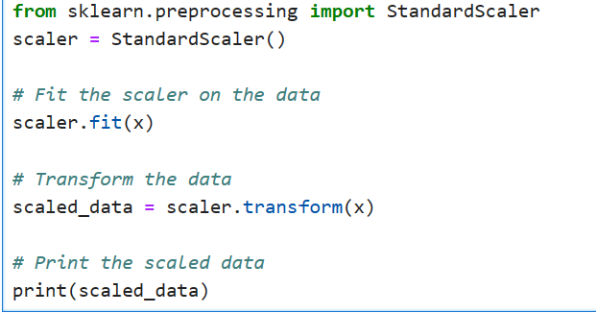
5) Feature Scaling:
Feature scaling is the process of normalizing the range of features in a dataset. Real-world datasets often contain features that are varying in degrees of magnitude, range, and units. Therefore, in order for machine learning models to interpret these features on the same scale, we need to perform feature scaling.

Slide 16
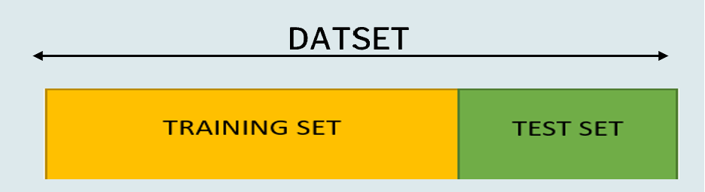
6) Splitting the Dataset:
One of the most important processes in data pre-processing involves splitting the dataset into train and test sets. By doing this, we can enhance the performance of our model and hence provide better predictability
from sklearn.model_selection import train_test_split

Slide 17
7) Mechine Learning Model:
Machine Learning is the subset of Artificial Intelligence.
ML enables computers to learn and improve from experience without being explicitly programmed.
ML is based on algorithms that learn from previous data.
With minimal to zero human intervention, machines and systems are able to analyse and understand data, learn from it and make decisions.
The level of performance will increase as we supply more information.

Slide 18
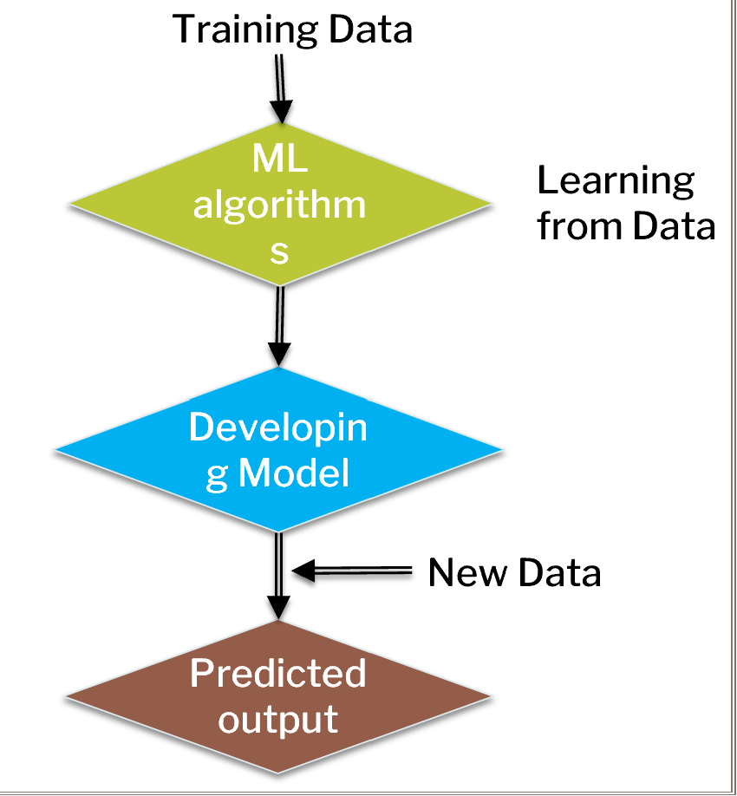

Slide 19
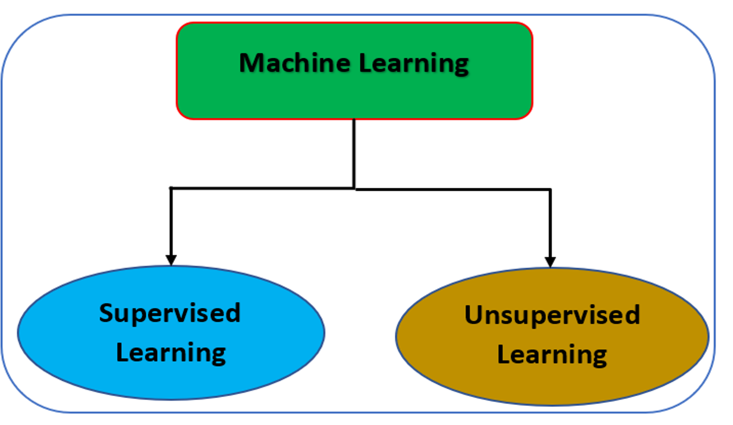
Classification Of Machine Learning:

Slide 20
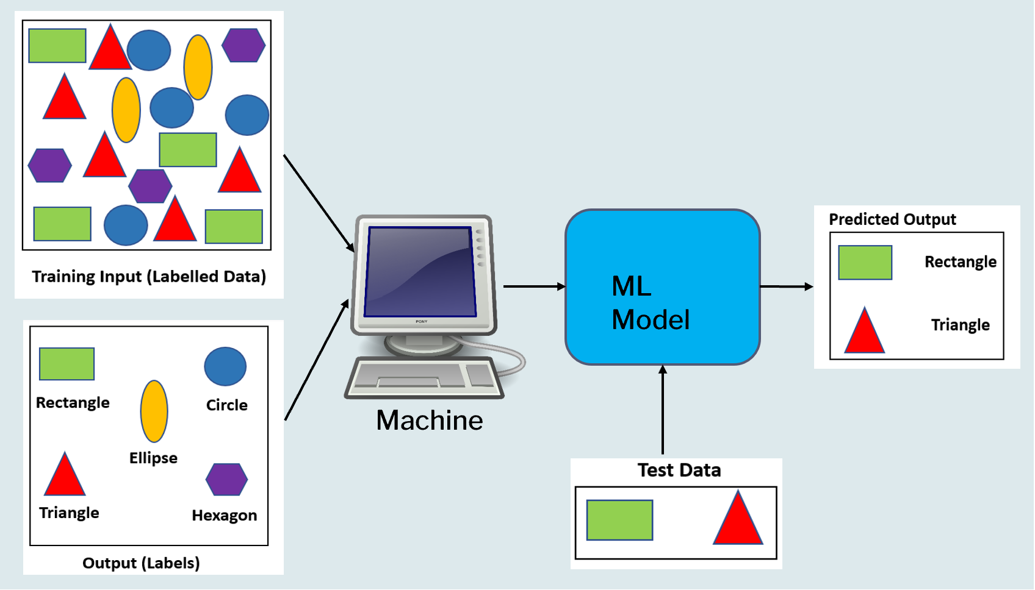
Supervised Learning:

Slide 21
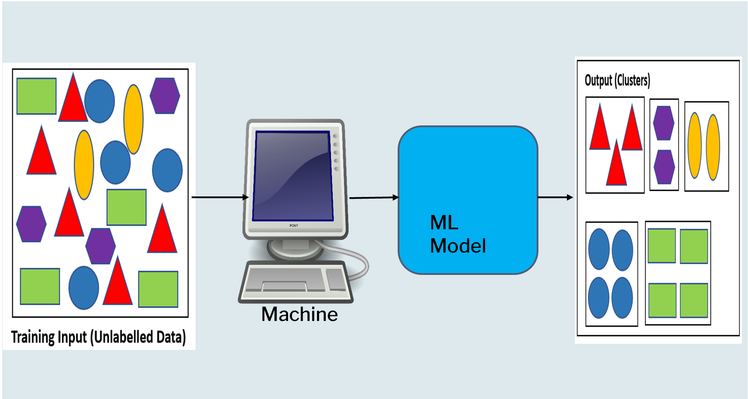
Unsupervised Learning:

Slide 22
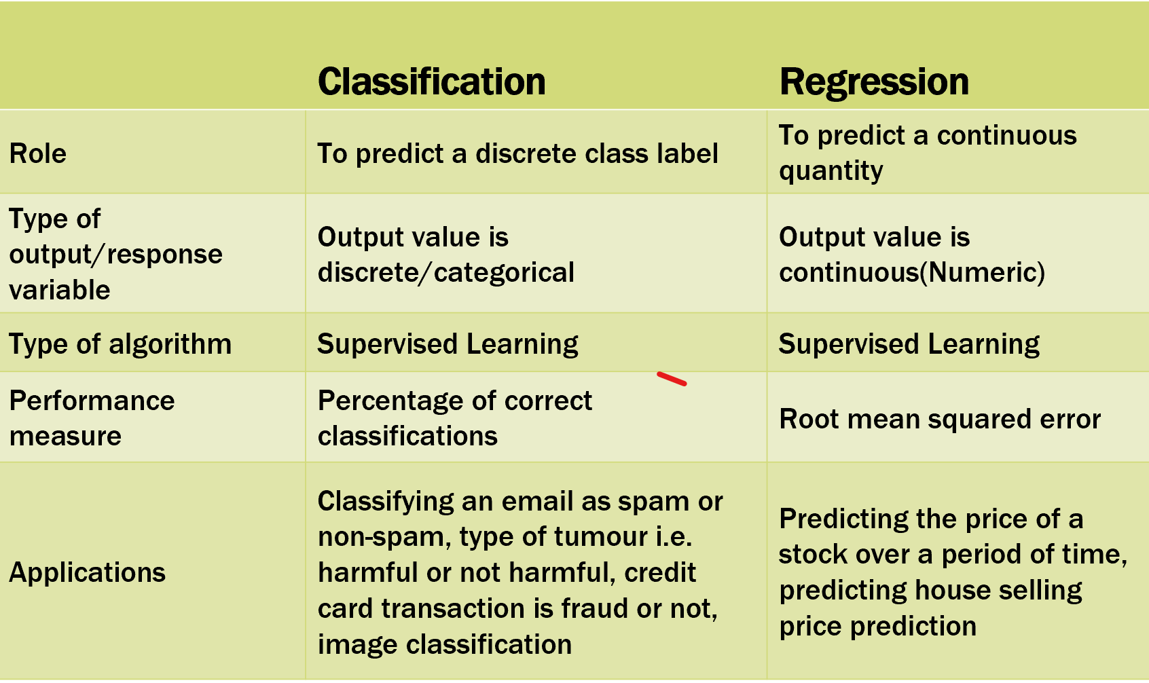
Classification of Supervised Learning:

Slide 23
Supervised learning alogorithm using here,
1--Logistic Regression
2--Decision Tree Classifier
3--Random Forest Classifier
4--Support Vector Classifier

Slide 24
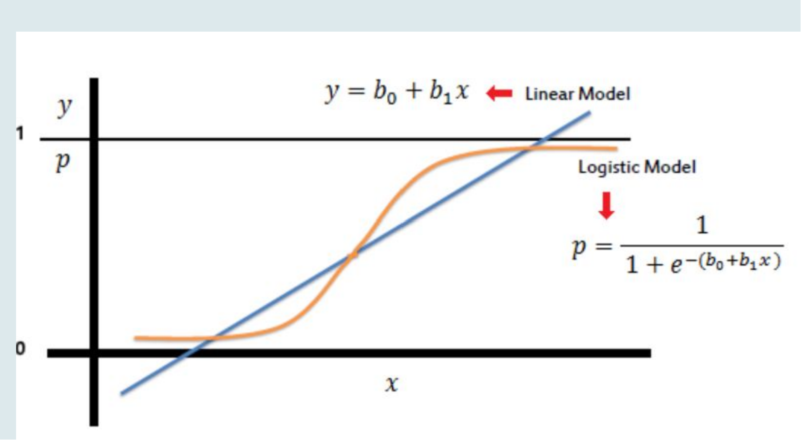
1-Logistic Regression:
Logistic regression is a statistical method used for predicting categorical outcomes. It is a supervised learning algorithm that is closely related to linear regression but adapted for binary or multi-class classification problems. The goal of logistic regression is to estimate the probability of an event occurring, which is typically represented as 0 or 1.

Slide 25
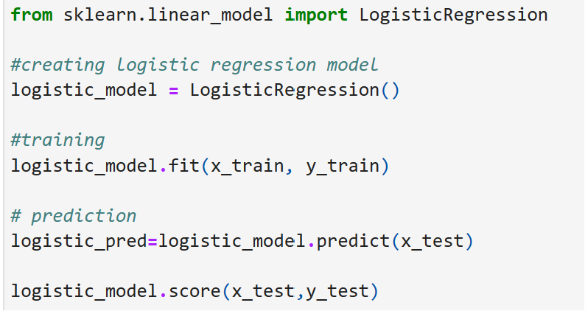

Slide 26
2-Decision Tree:
A decision tree is a supervised learning algorithm that can be used for classification and regression modeling, but mostly it is preferred for solving Classification problems
It is a flowchart-like tree structure where each internal node denotes the feature, branches denote the rules and the leaf nodes denote the result of the algorithm
It is called as decision tree because, similar to a tree, it starts with the root node, which expands on further branches and constructs a tree-like structure

Slide 27
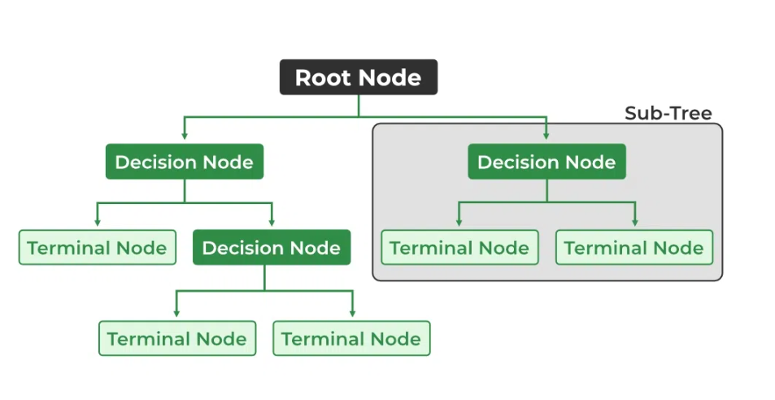

Slide 28
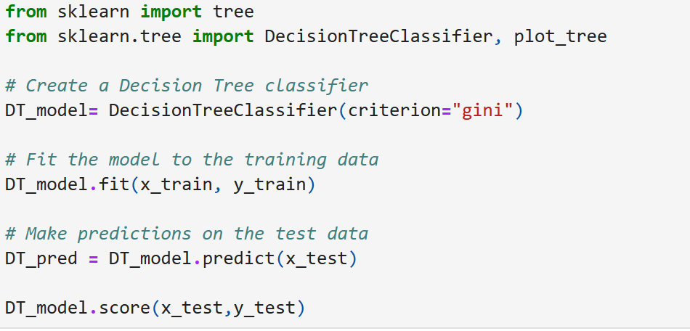

Slide 29
3-Random Forest:
Random forests or random decision forests is an ensemble learning method
Ensemble learning : a process of combining multiple classifiers to solve a complex problem and to improve the performance of the model
It can be used for both Classification and Regression problems in ML
For classification tasks, the output of the random forest is the class selected by most trees. For regression tasks, the mean or average prediction of the individual trees is returned

Slide 30
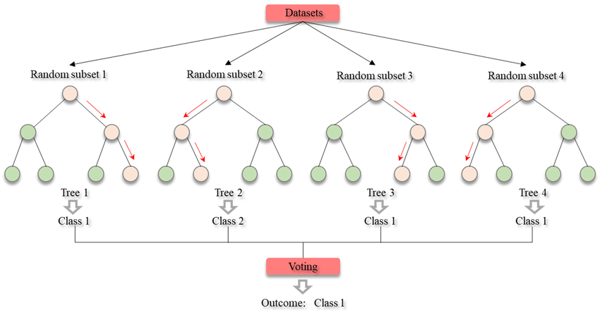

Slide 31
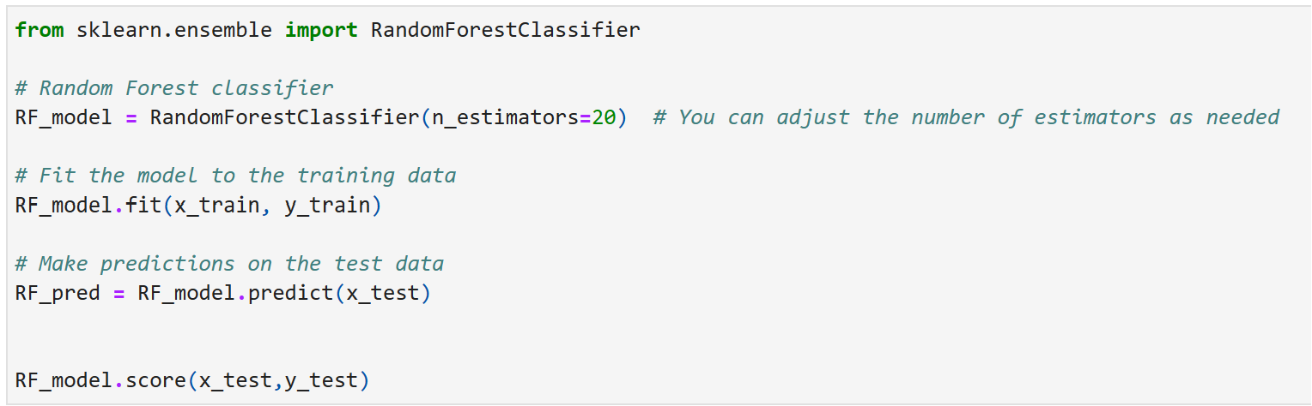

Slide 32
4-Support Vector Machine:
Support Vector Machine or SVM is one of the most popular Supervised Learning algorithms, which is used for Classification as well as Regression problems. However, primarily, it is used for Classification problems in Machine Learning
Goal: To create the best line or decision boundary that can segregate n-dimensional space into classes so that we can easily put the new data point in the correct category in the future. This best decision boundary is called a hyperplane.

Slide 33
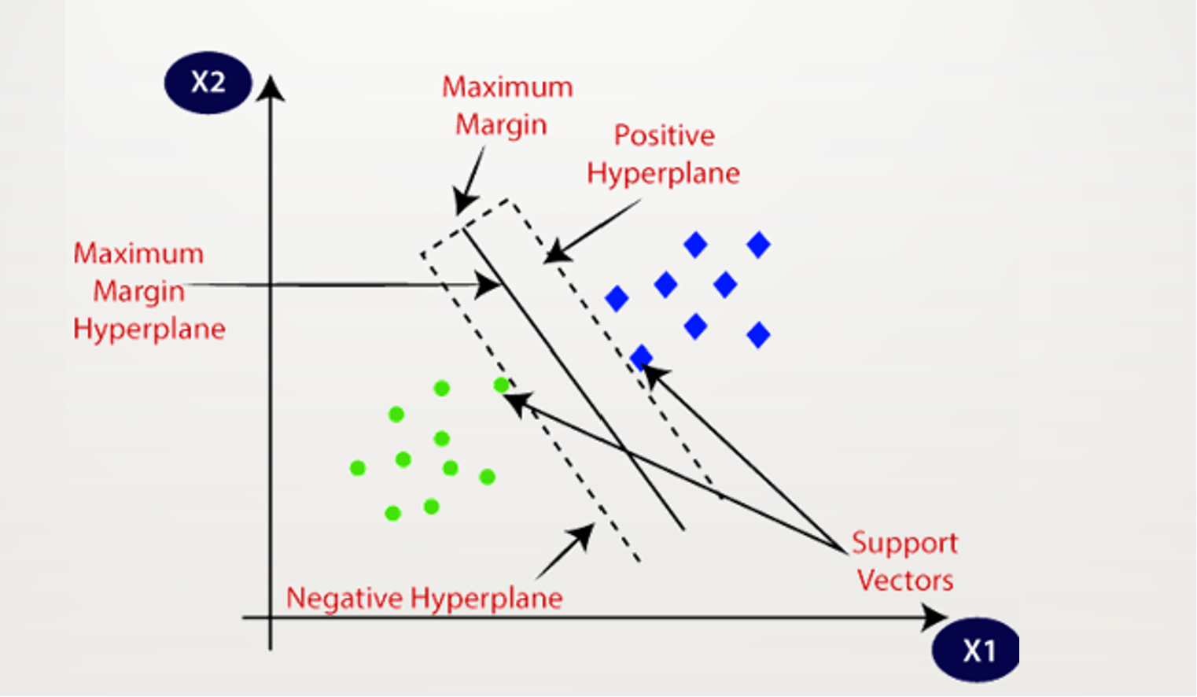
Two different categories are classified using a decision boundary or hyperplane.

Slide 34
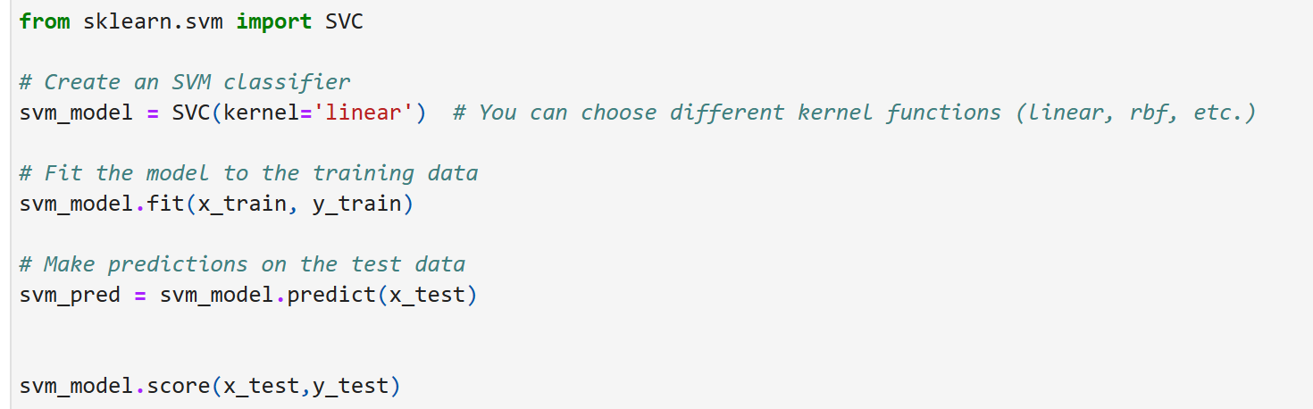

Slide 35
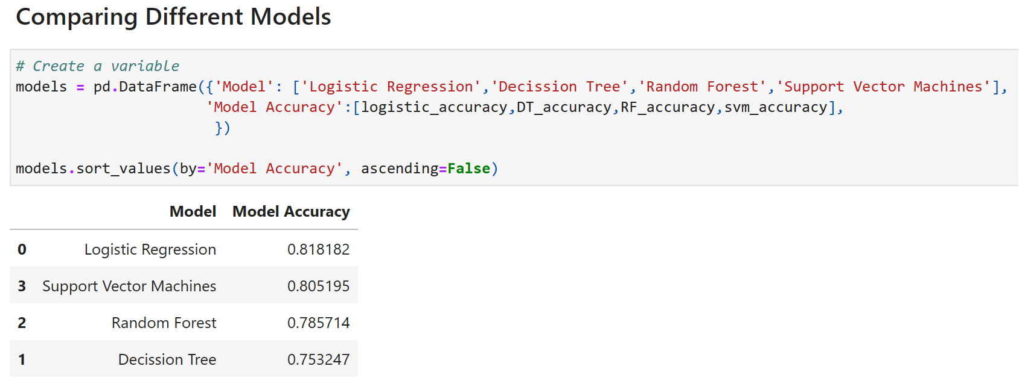
Result:

Slide 36
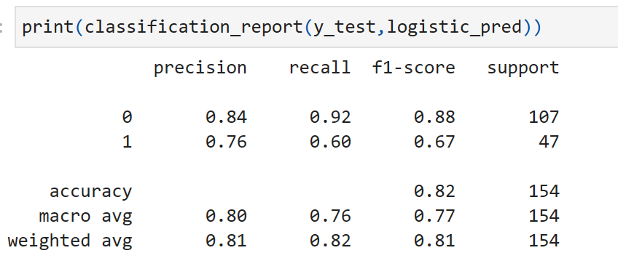
According to the accuracy scores, Logistic Regression has the highest accuracy, followed by Random Forest and Support Vector Machines. Decision Tree has the lowest accuracy among the models evaluated.
Logistic model accuracy is 0.8182
we determine that the best model for prediction is the Logistic Regression model.

Slide 37
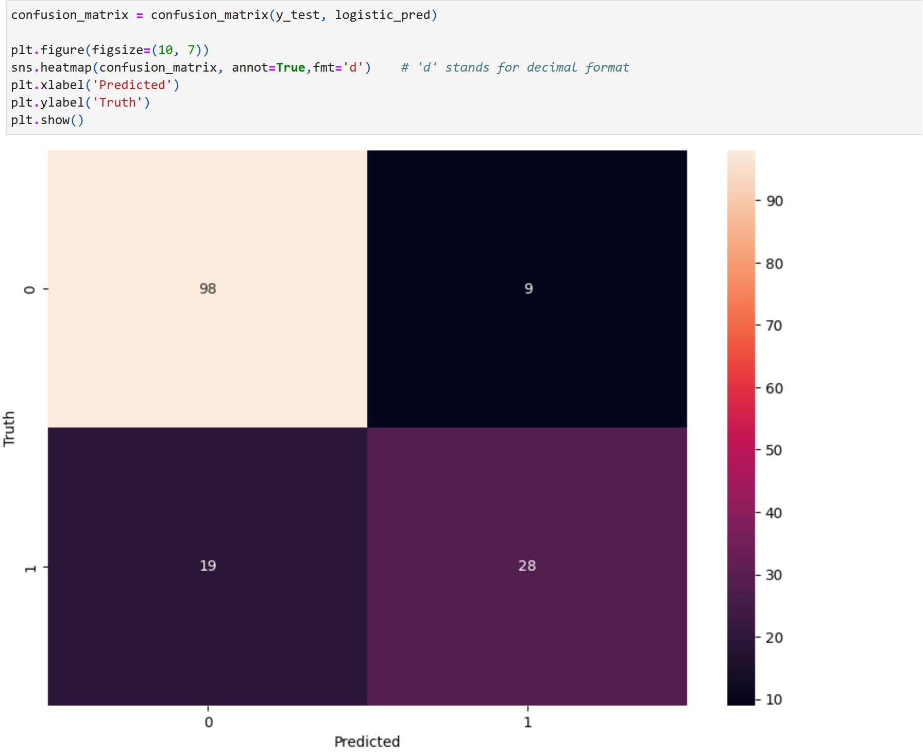

Slide 38
Conclusion:
From the confusion matrix we can see that: There are total 98+9=107 actual non_diabetic patients and the algorithm predicts 98 of them as non diabetic and 9 of them as diabetic. While there are 19+28=47 actual diabetic patients and the algorithm predicts 19 of them as non-diabetic and 28 of them as diabetic.

Slide 39
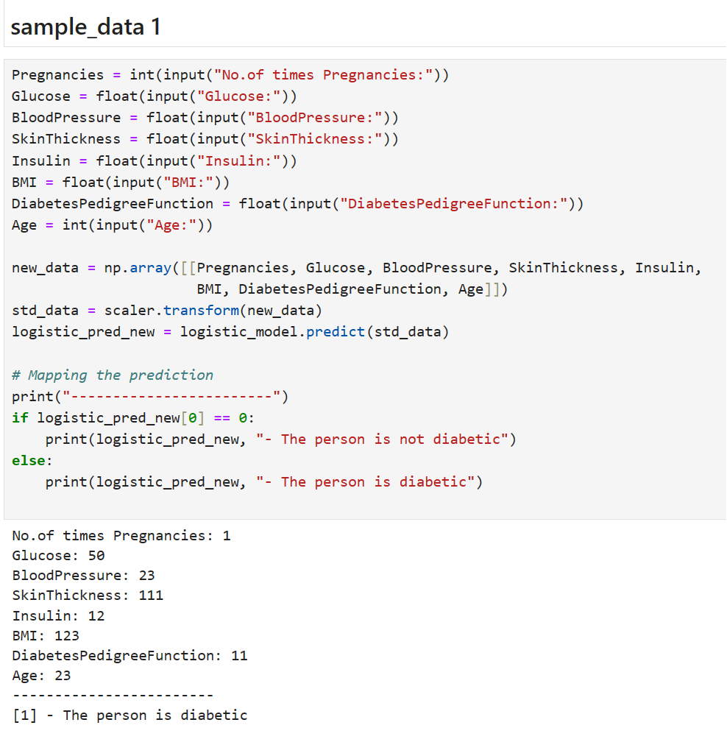
Prediction:

Slide 40
